Slide 1

AYUSH, DEEPAK & NIKHIL
FINAL YEAR, Computer Science & Engineering, Dual Degree Students
INDIAN INSTITUTE OF TECHNOLOGY DELHI
TRAILBLAZERS

Slide 2
PROBLEM
Multiple Car Parks in the University Campus
Difficult for visitor to know without visiting each carpark
Which car park is nearest to the destination?
Which car park has vacancy?
WASTES TIME AND FUEL

Slide 3
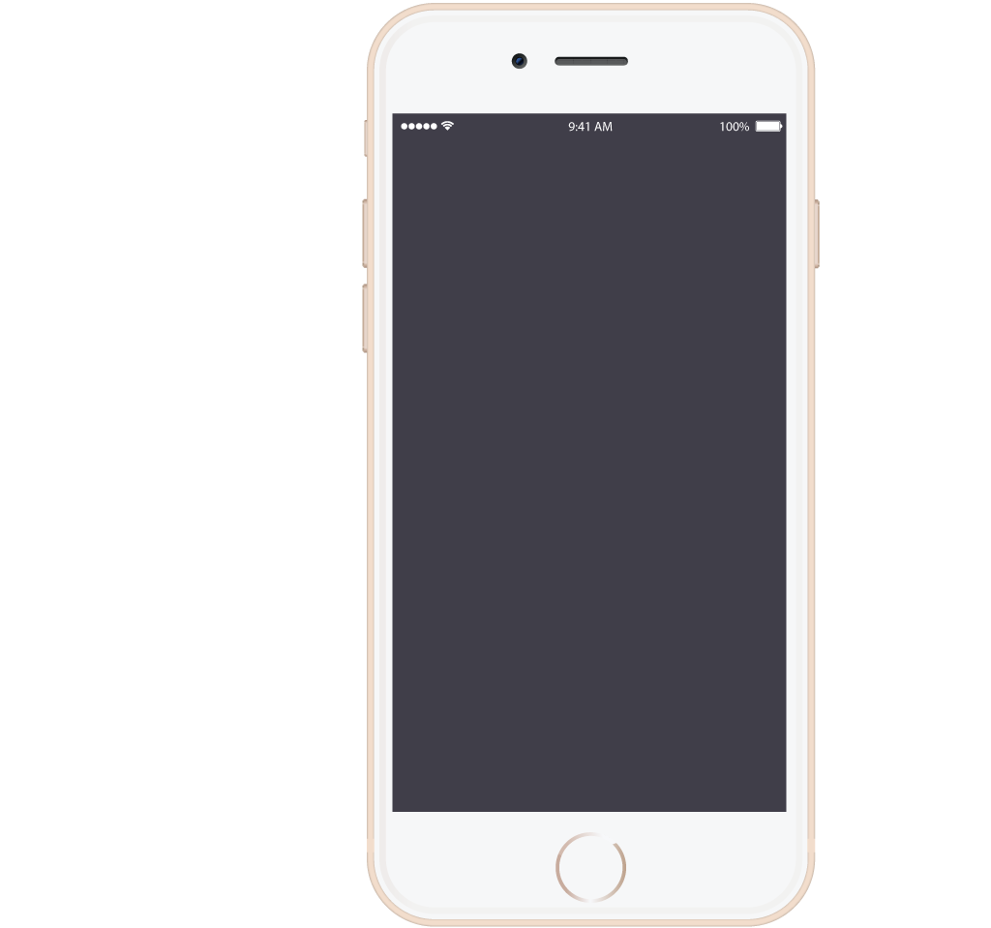
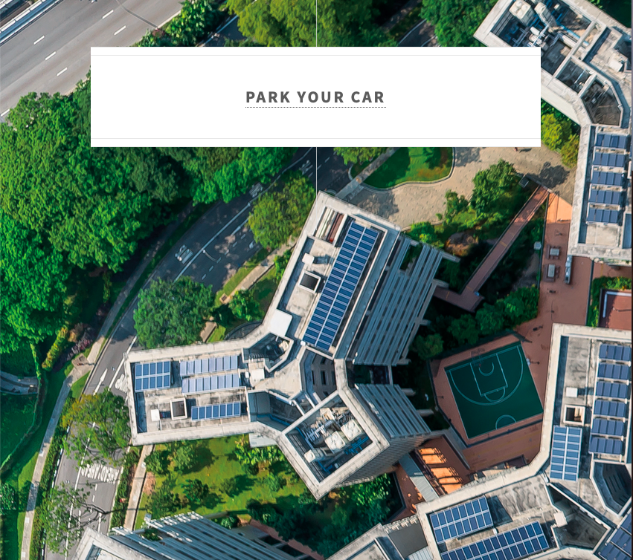
SOLUTION
DATA
Monitor Occupancy of each Car Park by gathering data from the IU based electronic car park system
INFORM
Inform visitor about nearest and cheapest car parks with respect to his destination
NAVIGATE
Navigate the visitor after he selects a carpark
REROUTE
Real Time Notifications & Re-routing in case car park gets full

Slide 4
SOLUTION: How Good ?
EFFECTIVE
USER-FRIENDLY
ECONOMIC
Success
Tackles the problem completely
Simple & Intuitive Interface
No App Installation Needed
Basic QR Code Scanning
Cross Platform
No Hardware Overhead
Minimal Server Costs
Innovative
Creative
Comprehensive
VEHICLE TYPES : Heavy Vehicles, Cars, Motorbikes, Bicycles
USER TYPES: VIP, Professor, Student, Staff, Visitor, Admin

Slide 5
TECHNOLOGY
Number One
Number Two
Postgres SQL based Robust Database System
Hosted on cloud-based Azure Platform
Number Three
Number Four
API Based Modular Code [Google Map APIs & self-made APIs]
Push Notifications via Service Workers
Number Five
Number Six
Bootstrap, Python, PHP, JS, HTML, CSS
Tested & Trusted by Realistic Simulations on Real World Data

Slide 6
Business Model
UTILITY
INNOVATION
SOCIETAL VALUE
SUSTAINABILITY
SCALABILITY
Greatly Facilitates visitors in finding appropriate parking lots
Makes way for a Smart Campus
Saves Fuel
Saves Time
Extremely Low
Maintenance Overheads
Easily Scalable
to
Entire City

Slide 7
Thank
You

